Slide 1

Check for my Excel Worksheet!

Slide 2
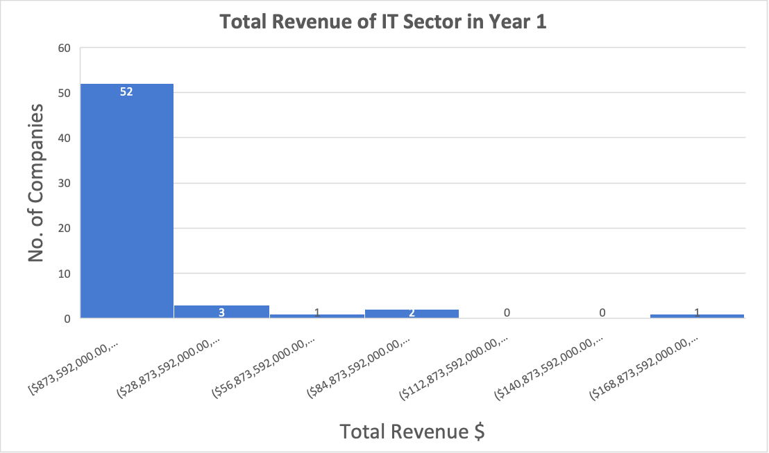
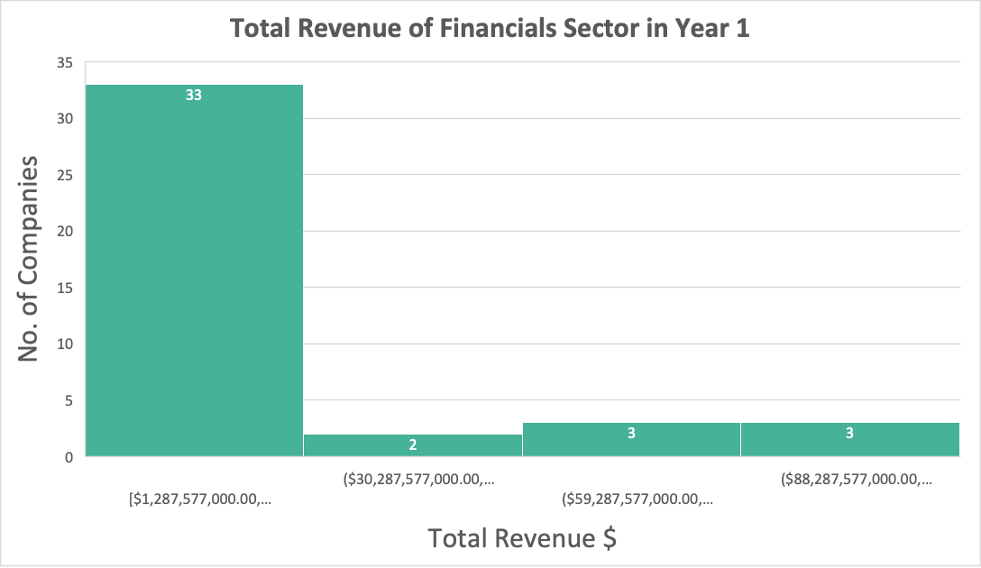
Does the IT sector have a similar Total Revenue to the Financials sector in Year 1?
As we see, the are two histograms one for the Total Revenue of the IT sector and one for the Financials sector, both in Year 1.
Both distributions are right-skewed. That means both are higher than the median.
The mean for IT is about $15,546,943,135.59 and for Financials is about $21,419,213,414.6
Whereas median for IT is $4,436,000,000.00 and the median for Financials is $10,259,000,000.00
From the summary statistics, we can see that the IT sector has a total revenue of slightly more than the Financial sector about 39 million.

Slide 3
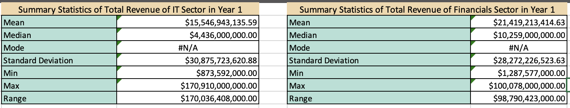
Does the IT sector have a similar Total Revenue to the Financials sector in Year 1?
‏We find the Standard Deviation for total revenue in Year 1 for the IT sector is $30,875,723,620.88 which is very high, and for the Financials sector is $28,272,226,523.63 which is also high, but it's not exotic because the range of IT sector companies is $170,036,408,000.00 which is a very high number and $98,790,423,000.00 for Financials sector companies which is also high number.

Slide 4
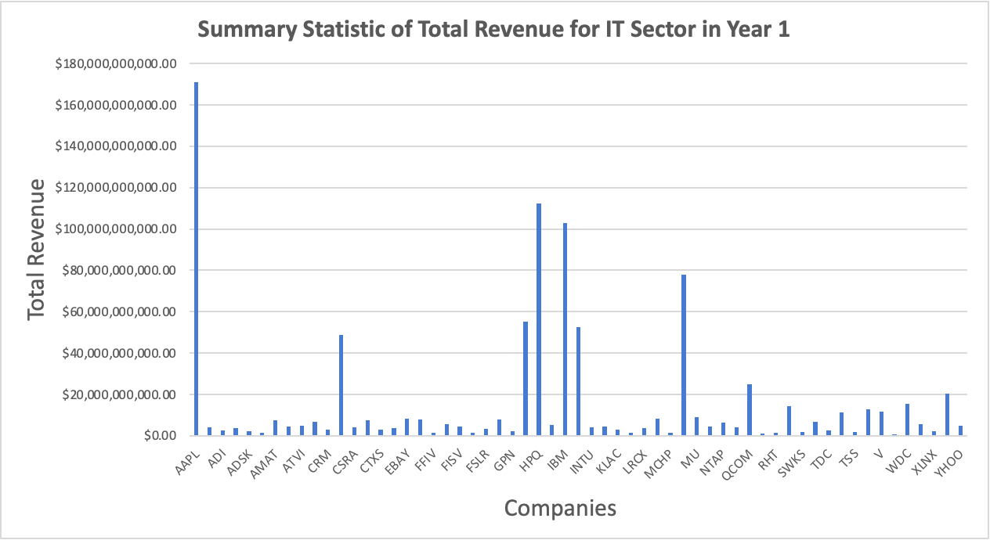
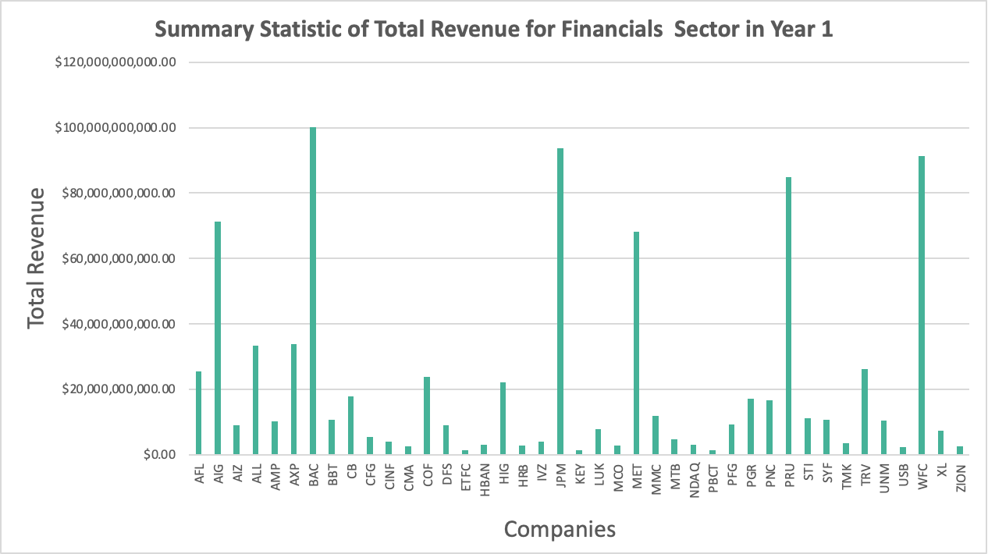
Summary Statistic of Total Revenue for IT Sector and Financials in Year 1
As we see, in the IT sector the Apple Inc. (AAPL) has the most total revenue of $170,910,000,000.00
As we see, in the Financials sector there are 3 top companies that have the highest total revenue, first one Bank of America Corporation (BAC) has the most total revenue of $100,078,000,000.00 and the second one is JPMorgan Chase & Co. (JPM) has a total revenue of $93,646,000,000.00 and the last one is Wells Fargo & Company (WFC) has a total revenue of $91,247,000,000.00

